Slide 1
Capstone Project
Yes bank closing price prediction Submitted by: Kabeer Pande

Slide 2
Table of Content
Introduction
Problem Statement
Data Description
Data Cleaning
Exploratory Data Analysis
Machine learning Models
Data modeling
Conclusion

Slide 3
Introduction
Yes Bank is a well-known bank in the Indian financial domain. It offers
wide range of differentiated products for corporate and retail customers
through retail banking and asset management services. According to the
data shared by NPCI (National Payments Corporation of India), Yes Bank
processed 25.94 million transactions amounting to INR 14811.73 crores
through its own UPI app in July 2021. Since 2018, it has been in the news
because of the fraud case involving Rana Kapoor.

Slide 4
Problem Statement
Yes Bank is a well-known bank in the Indian financial domain. Since 2018, it has been in the news because of the fraud case involving Rana Kapoor. Owing to this fact, it was interesting to see how that impacted the stock prices of the company and whether Time series models or any other predictive models can do justice to such situations. This dataset has monthly stock prices of the bank since its inception and includes closing, starting, highest, and lowest stock prices of every month. The main objective is to predict the stock’s closing price of the month.

Slide 5
Data Description
Dataset have 185 rows and 5 columns
•Date_added: Date of record
•Open :Opening price of month
•High : Highest price of month
•Low : Lowest price of month
•Close : Closing Price of month

Slide 6
Data cleaning
Dataset does not have any null values.
There are no duplicate rows in the dataset.
We change the date format from object type to datetime format

Slide 7
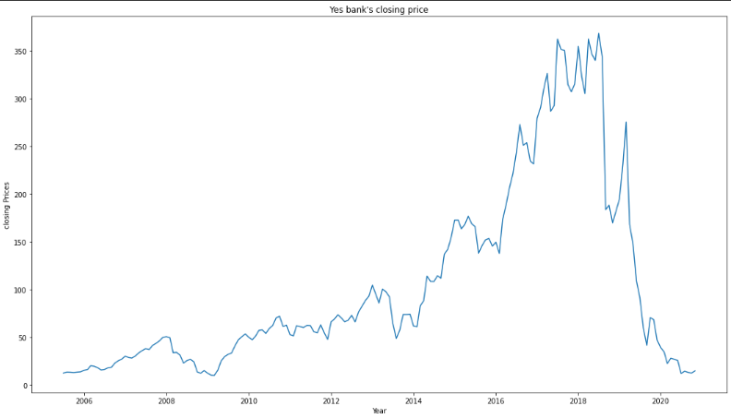
Exploratory Data Analysis
Yes Bank closing price
It is apparent that stock was performing good until the sudden fall in 2018. This sudden fall in the stock closing price can be attributed to the fraud case.

Slide 8
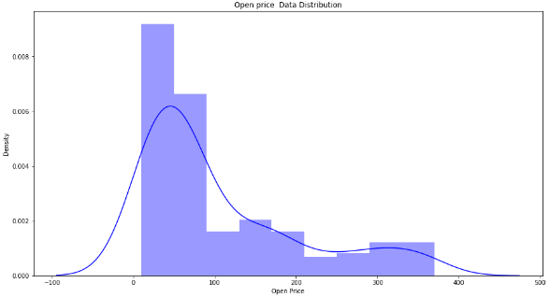
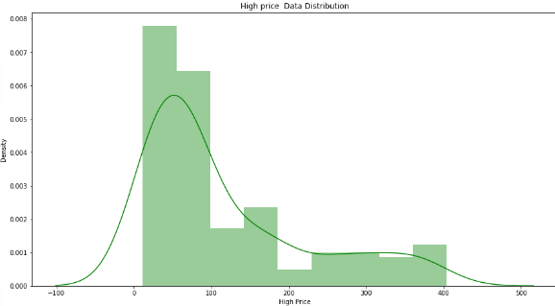
Data Distribution

Slide 9
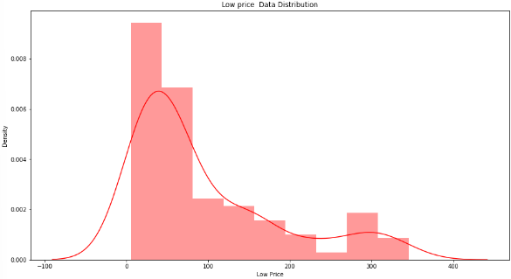
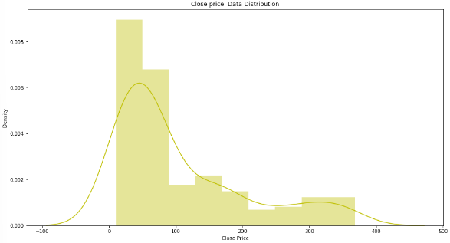
From the above graphs we can see that the data is rightly skewed. We will have to change this data to
normally distributed data before applying Machine Learning models.

Slide 10
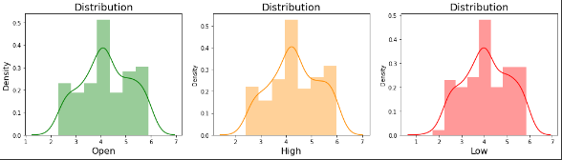
Data distribution after applying log transformation
Now our data is uniformly distributed.

Slide 11
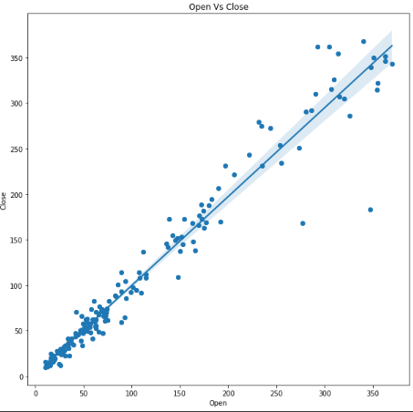
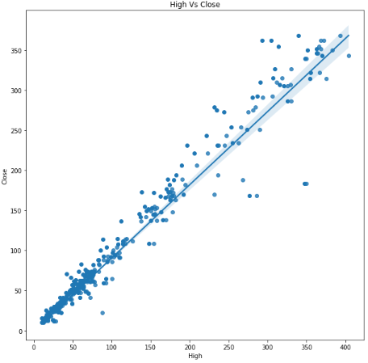
Relationship between dependent variables and independent variables.

Slide 12
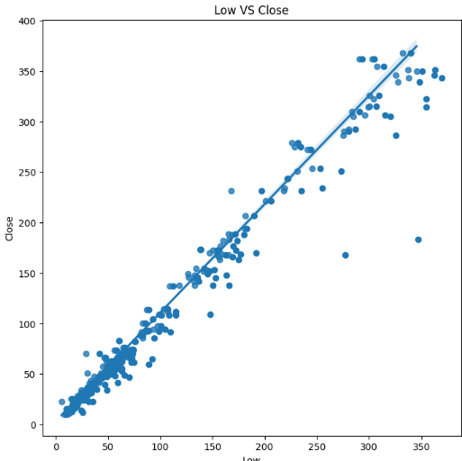
In this independent variables are High,Low,Open features and dependent variable is close column.
From the above graphs we can say that independent and depenent variable are linearly related to each other.

Slide 13
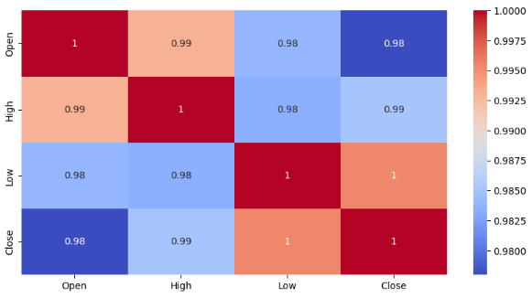
Correlation
The heatmap indicates there is high correlation among our variables. To handle this we will use regularization techniques like L1 and L2.

Slide 14
Data modeling
Our data was not normally distributed so we applied log transformation to our dataset.
Then we assigned independent and dependent variables.
Then we did train test split in which 20% is taken as test and the rest is training data.
X_train has 148 rows and 3 columns.
X_test has 37 rows and 3 columns

Slide 15
Implementing machine learning models
•Linear Regression
•Lasso Regression
•Ridge Regression
•Elastic Net Regression
All of our ML models have similar accuracy of 98.9%.

Slide 16
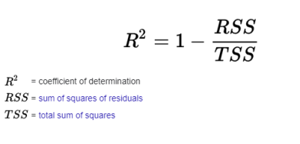
R squared
R-squared is a statistical measure that represents the goodness of fit of a regression model. The ideal value for r-square is 1. The closer the value of r-square to 1, the better is the model fitted.

Slide 17
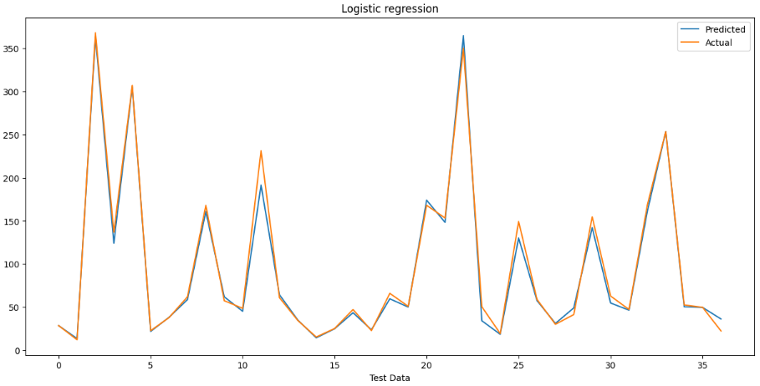
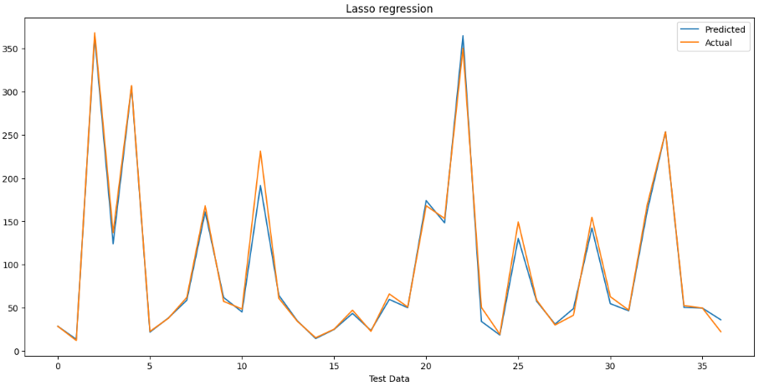
Prediction of each model

Slide 18

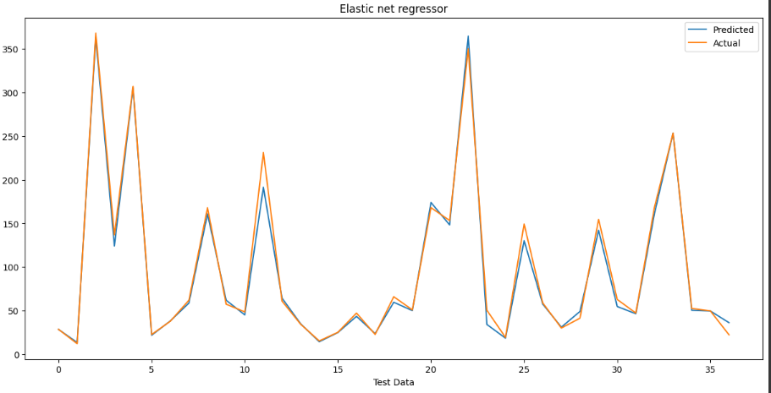
We can see that every ML model has similar prediction graphs. Therefore we can choose any model.

Slide 19
Conclusion
This project is about the of Yes bank's stock price prediction.
This dataset has 185 rows and 5 columns.
Histogram plot of all feaures are rightly skewed.
It is concluded by the project that The sudden crash we see in the graph after 2018 is due to the spread of fraud case news among Stock Holder's which created bearishness in the stock prices.
In the Dataset Close Column is dependent Variable and Open, High, Low column's are independent features.
Dependent and Independent features are linearly related with each other.
The Heatmap showed high correlation between the features.
Then We implemented Linear regression ,Lasso regression,Ridge regression and Elasticnet regression and the accuracy score that we got for all the models is almost 99%,which shows that we achieved a good fit model for our dataset.

